Slide 1
Supporting Literacy
March 4, 2026

Slide 2
Agenda
Introductions
Literacy at Palmer
Literacy at Home
Literacy in the Community
Questions?

Slide 3
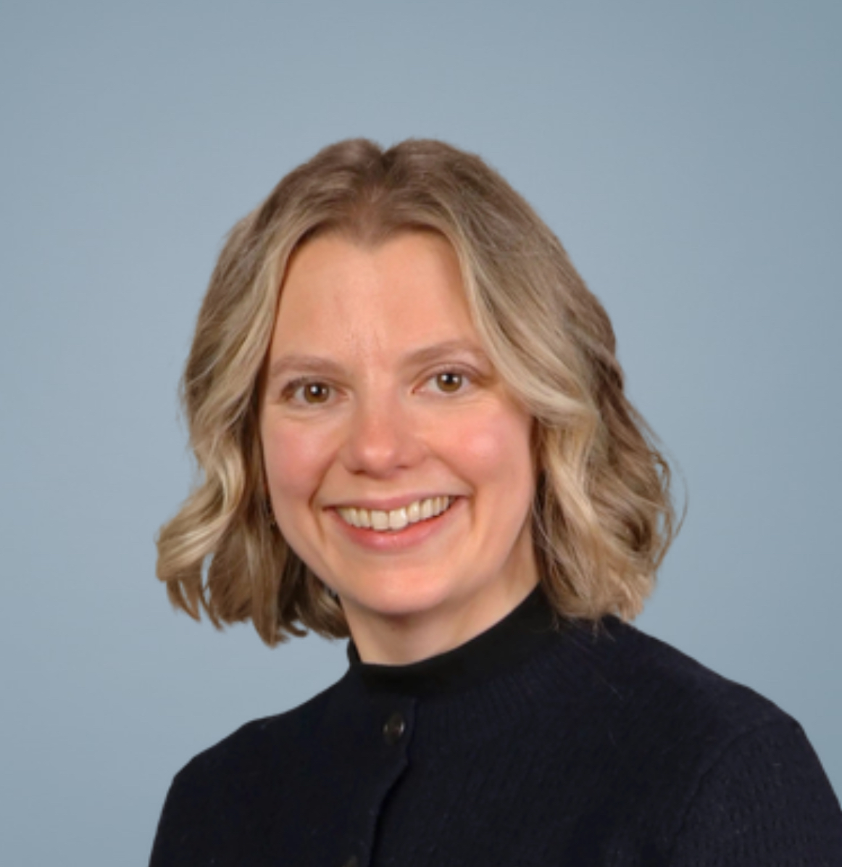
Meet Ms. Epp
Samantha Epp:
Palmer Literacy Facilitator
Literacy = reading, writing, and communication skills
Literacy facilitator = support literacy initiatives at Palmer
  Lead grade 8 team
  Provide professional development opportunities to staff
  Identify appropriate strategies to support student needs

Slide 4
Literacy at Palmer
What are we doing?
Focusing support at the grade 8 level
Reading assessments to track progress (fall, winter, spring)
Key areas of focus:
  Word skills
  Identifying main ideas and details
  Note-making
  Making connections
Other skills:
  Agenda use
  Organization

Slide 5
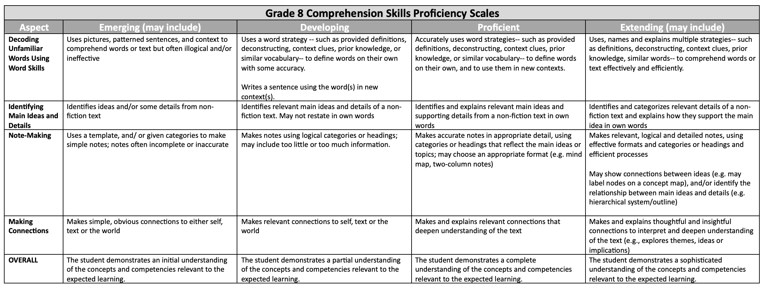
What do we expect our grade 8 students to be able to do?

Slide 6
Literacy at Home
How can you support literacy at home?
Talk to your child:
  Ask your child to tell you about their day at school
    What was the most interesting thing you learned today?
    Tell me what you did in Science/PE/Foods/etc… class!
    Did you do anything fun at school today? Tell me about it!
  Talk about what’s going on in the world and make connections to their world and what they’re learning

Slide 7
Literacy at Home
How can you support literacy at home?
Develop background knowledge:
  Go out and do activities with your child
  Discuss what’s going on in the world
Model literacy
  Go to the library together
  Read in front of your child
  Read a book with your child
Limit screen time
  Screen-free dinner time → prioritize family conversations
  No screens 1 hour before bed

Slide 8
Literacy in the Community
Richmond Public Library
  Conversations in the Library
  Theatre Improv for English Language Learners
  Teen Board Game Hangout
  Teen Bookclub
  https://yourlibrary.bibliocommons.com/v2/events?audiences=5ab2cc261cc59e4b41421b11
Richmond Continue Education
  https://ce.sd38.bc.ca/
Volunteering opportunities
  Richmond Oval
  https://richmondoval.ca/contact-us/volunteers/
  Richmond Cares, Richmond Gives
  https://www.rcrg.org/VolunteerNow
  YCC

Slide 9

Literacy in the Community

Slide 10
Questions?

