Slide 1
Literacy Assessment

Slide 2
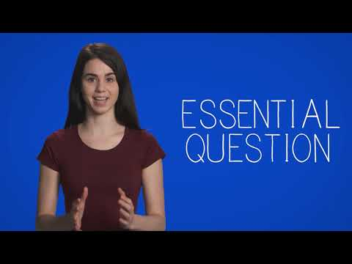

Slide 3
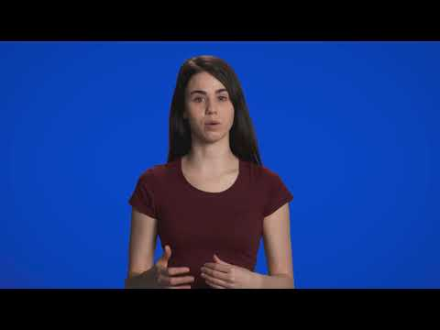
Notes:
Question Types

Slide 4
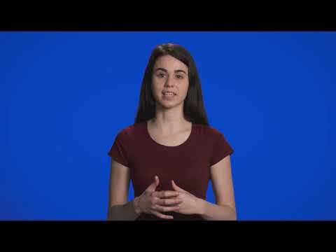
Notes:
Part A video

Slide 5
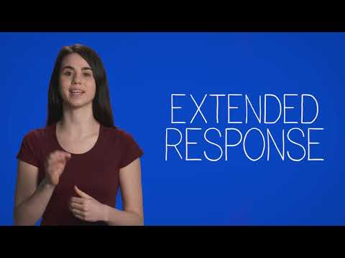
Notes:
Part B video

Slide 6
So to review...
One overarching topic and essential question
Topic likely to do with Science or Social Studies
Part A includes non-fiction infographics and articles
Write an essay connecting the “readings” from Part A
In Part B choose between “information” & “expression”
“Information” is similar to Part A
“Expression” will include a story
Both options include a writing section

Slide 7
1.PART A
Title page tells you what you are expected to do
2 infographics
2 reading passages
Fill out essay planner (required!)
Write structured, multi-paragraph essay

Slide 8
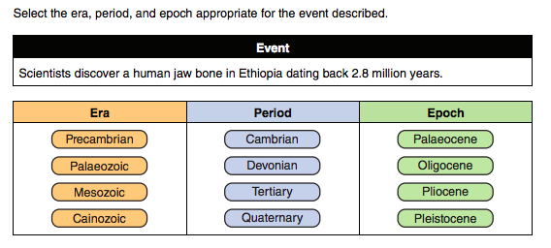
A: Reading Comprehension
Very important to read all the questions carefully
Some are just normal multiple choice questions
BUT some require multiple answers:
How many answers should be selected for this question?

Slide 9
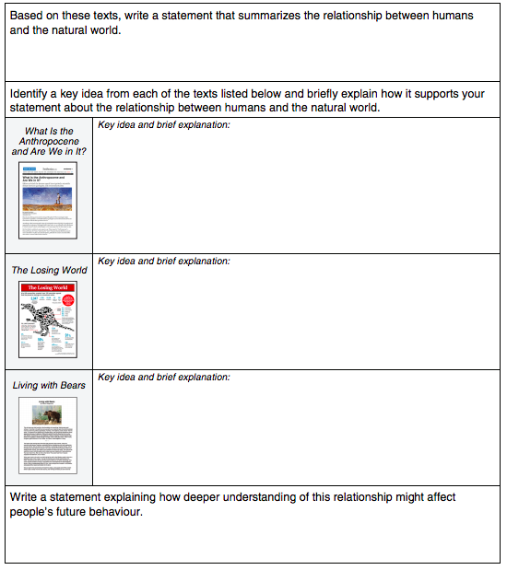
A: Graphic Organizer
Essentially, the essay planner
Notice how it’s broken down into sections → paragraphs of essay
Key Points:
Be concise! Point form!
Be specific! Do not summarize the whole article or infographic!
Remember to tie it back to your THESIS

Slide 10
A: Writing
Must be multi-paragraph essay
Follow the graphic organizer to help with structure
Ideal response:
Well-supported with quotes
Not just a summary of each reading
Shows clear link between readings
SYNTHESIZES: how do the readings all work together to prove your point!
PROOFREAD!

Slide 11
2.PART B
Title page tells you what the two choices include reading-wise
Both choices include a written section
The question at the top is what you’ll be writing about!
Pick to your strengths and interests

Slide 12
Part B: Writing
Freedom to choose format
Essay
Fictional Story
Personal Memoir
Poem
Pick to your strengths and interests
Ideal response is:
Unique
Insightful
Sophisticated
I.e. if they want you to write about how to help the Earth, don’t just write about recycling.
PROOFREAD!

Slide 13
Time Management
Up to 3 Hours provided, use it all
Suggested times on the assessment is for 2 hours
Suggested times below for 3 hours
Part A: Reading | Part A: Planner | Part A: Essay | Part B: Reading | Part B: Writing
~30 min | ~20 min | ~50 min | ~30 min | ~50 min

