Slide 1
The G.L.A
Graduate Numeracy Assessment - part B -
Literacy for expression

Slide 2
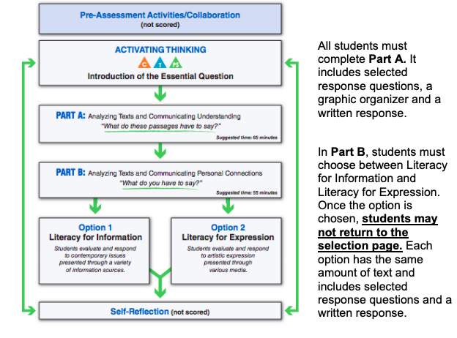
Part B
You have a choice here. This slideshow concerns option 2

Slide 3
Part B - You’ll have a choice…
You will be given two optional paths. In advance, consider your strengths and interests as a reader.
Do you prefer informational texts like infographics and articles or do you prefer to read literature like stories and memoirs?
The amount of reading within each option is equivalent.
The Part B preview page provides a snapshot of each option.
Once you have made your choice, you cannot switch back.

Slide 4
This is the example question from the sample assessment online

Slide 5
Points to notice
Yes you can write in short story style (narration.)
Creatively or critically (ie can be fictional or non fiction)
Any format (short story, essay…)
Narration, exposition, persuasive description or combination
Detailed: Use your language! Use your 5 senses. Use your vocabulary.

Slide 6
What you’ll need to do
Students are asked to incorporate a personal connection, bringing their own knowledge, experiences, and creative notions to a piece of written communication that addresses an aspect of the essential question within the part of the assessment the student has selected.
For this written response, students will be assessed on the originality of their perspective and insight, as well as their skillful development of ideas.
The sophistication of written communication and organizational structures will also be taken into account in a holistic 6 point scale.

Slide 7
You get to choose your path
Part B Constructed Response Tips:
You will be given two optional paths. In advance, consider your strengths and interests as a reader. Do you prefer informational texts like infographics and articles or do you prefer to read literature like stories and memoirs? The amount of reading within each option is equivalent.
The Part B preview page provides a snapshot of each option. Once you have made your choice, you cannot switch back.

Slide 8
Do some planning
Use the writing process for each of your extended written responses:
Brainstorm, generate ideas or make notes.
Outline or organize your ideas.
Use paper provided if that is how you usually plan.
Proofread carefully: including spelling, capitalization (beginning of sentences), paragraphing, end punctuation.
Formal writing: avoid slang, avoid abbreviations, tone, etc.

Slide 9
How will you be assessed? rubric
6/6 The six response is superior in terms of approach to topic, originality of thought and/or use of language: • addresses the topic with creative insight, sophisticated understanding • perspective is unique; ideas are convincing and skillfully developed • writing style is effective and engaging; despite its clarity and precision, the response need not be error-free
5/6 The five response is proficient in terms of approach to topic, originality of thought and/or use of language: • addresses the topic with some insight and in-depth understanding • perspective demonstrates maturity; ideas are interesting and well developed • writing reflects a strong command of the conventions of language; errors may be present, but are not distracting

Slide 10
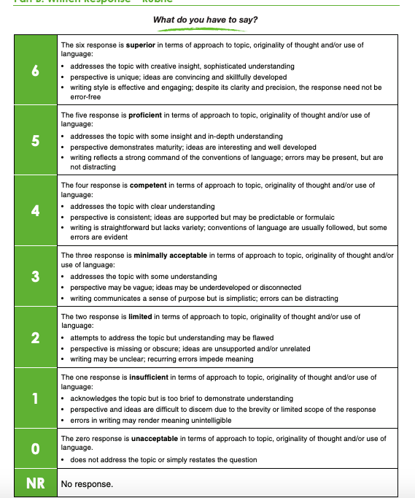

Slide 11
Sample 6/6 - exposition
Humans, given the power they hold in the food chain, have a moral obligation to see other animals as their own equals. It is the responsibility of humans to attempt to coexist with the other animals in the natural world. As was once stated by Gandhi, "The greatness of a nation and its moral progress can be judged by the way its animals are treated." After careful interpretation of this quote, we can conclude that Gandhi is calling on Humans to accept their moral responsibility to coexist with other animals and treat other animals well. Humans have developed such an extensive amount of technology that one could argue that humans are at the top of the food chain. Currently, we as humans have the power and authority to cause extinction to any species, and there would be no outside forces to stop us. As is shown in "The Invaders" by James A. Michener, it is very easy for someone to contribute to the extinction or end of another species. It is our responsibility to learn to coexist with other members of the earth. In the story, one of the characters was first inclined to take the lives of the armadillos on his property. At first, he did not realize that all animals share the earth, but he later learned to appreciate and coexist with the armadillos. This story provided an important lesson. We have the power to end a species, but we should not abuse that power and we should instead learn to coexist with other species so that we can learn to appreciate them and grow happier. As humans, it is our responsibility and obligation to attempt to appreciate other species and learn to coexist with them. If humans never stopped to appreciate another species and was always focused on their ability to end that species, the world today would be much less diverse than it is.

Slide 12
Sample 5/6 – narration / fiction
THE BEE
"Ouch!" Ally cried as she looked down to the little black and white striped creature on her arm. "It stung me!". The limp creature rolled off her arm onto the ground, leaving only a little black twig in Ally's arm. "Quick, Dave, Help me get this stinger out of my arm!" Dave walked over and examined the sting. "Hold still." He told her as he pulled out the stinger. "I hate bees!" Ally screamed. "I never want to see another one in my entire life! I want them all dead!" The next day Ally and Dave were walking in the park when Ally spotted one. A bee. It was laying on the pavement on top of a dead flower. Ally walked over to it carefully. "Die devil creature, die!" She screamed, raising her foot to stomp on the small bug. "No!" Dave yelled. Ally stopped her foot in midair and looked back. "We need bees!" Dave announced, walking his sister away from the innocent little bee."Bee's spread pollen so that we can have healthy fruits and veggies to eat. We need bees to survive!" "But yesterday one stung me!" Ally protested. "Only because you were bugging it," Dave calmly replied. If we leave each other alone, then we can live together in harmony. Its our obligation to not only bees, but all living things." "Okay," Ally said meekly. "I'll try to leave them alone." "That's the spirit!" Dave replied. They walked around the bee, and continued their stroll

Slide 13
Insider tips
· Part B: Written Response
Weak papers were very short and generalized.
Strong papers were most often narrative.
Students often neglected to use correct capitalization and end punctuation.
Even when multi-paragraph compositions were requested, many neglected to separate their ideas into paragraphs.
Many students neglected to do even rudimentary proofreading and it affected their mark.
Personal note from a marker: “I saw the word gonna so many times, I almost cried.”

Slide 14
Remember, good narrative writing…
Has a good title
Starts with a hook, engaging the reader
Tries to use multiple senses (sight, hearing, taste, touch, smell)
Uses rich vocabulary and avoids ordinary words like “good” or “pretty”
Tries to use dialogue and action
Doesn’t forget poetic devices like similes, metaphors, personification, symbolism, allusion…
Remembers sound devices like alliteration and assonance
Ends with a bang, summarizing / typing up narrative.

Slide 15
Questions? Let’s do some writing!
Constructed response: What do you have to say?
Topic: To what extent do environmental factors impact sleep and health?
Criteria:
· Communicate your insight into this topic in a well-developed response.
· You may respond creatively or critically, using any written format
· Methods of development may include narration, exposition, persuasion, description, or any combination of these.
· Your thinking should be sufficiently detailed to thoroughly demonstrate your thinking

